Slide 1
INVENTORY CONTROL SYSTEM (ICS)
Developed Using Python, Tkinter, and SQLite
Presented by:
Richard Mkandawire
24311351026

Slide 2
Project overview
Content:
Objective:
The goal of this project is to create a desktop-base inventory control system with a user-friendly graphical interface.
It includes functionalities such as product management, login authentication and stock tracking using Python’s Tkinter library and SQLite database

Slide 3
Conti…
Tools and Technologies Used:
Python: Main programming language
Tkinter: For GUI development
SQLite: Lightweight relational database for storage
Other Libraries: Sqlite3, tkinter.ttk for treeviews, etc.

Slide 4
System features
Content:
Core Features of the Inventory System:
Login System: Secure login using hardcoded admin credentials (admin / admin)
Product Management: Ability to add, view and update product details (name, price and quantity)
Stock Management: Update products quantities based on stock movements
User-friendly GUI: Intuitive interface for easy interaction
SQLite Database: All data(products, stock, admin) stored in a local SQLite database for persistence

Slide 5
Login System
Content:
Login Process:
Users must authenticate using the admin username and password (admin/ admin)
If the credentials match, the user is granted to access to the inventory system
Invalid credentials display an error message
When typing password display stars (*) for security

Slide 6
Add Product
Content:
The “Add New Product” screen allows the user to input details for a new product
The fields include:
Product Name
Price
Quantity
When the “Save” button is clicked, the product is stored in the product table in the SQLite database

Slide 7
View Products
Content:
Functionality:
Users can view all products in the system displayed in a sortable table (Treeview)
Columns include:
Product ID
Name
Quantity
Price
- Search functionality is available to find specific products by name

Slide 8
Stock Management
Content:
Functionality:
The stock management section allows users to update the quantity for a selected product
Users select product from drop down list, the input the new quantity
Upon clicking the “Update”, the product’s quantity is updated in the database

Slide 9
Database Structure
Content:
Database Design:
Admin table: Stores admin credentials
Product table: Stores product details such as name, quantity and price

Slide 10
Future Enhancements
Content:
Planned Features for the Future:
User Role Management: Implement roles (Admin, User) with restricted access
Export Data: Ability to export product list and transaction history to CSV or PDF
Low Stock Alerts: Notification when a product’s stock falls below a threshold
Inventory Analytics: Generate reports or visualization showing inventory trends
Transaction Logs: Keep a history of product stock changes with timestamps

Slide 11
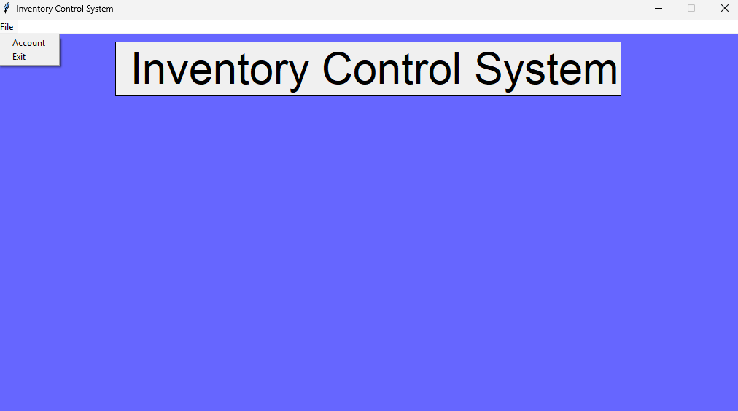
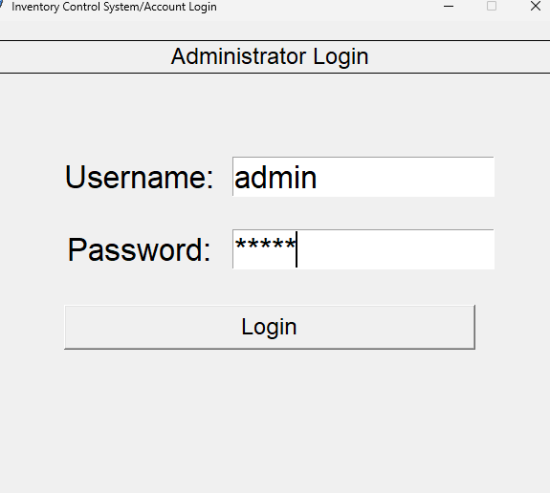
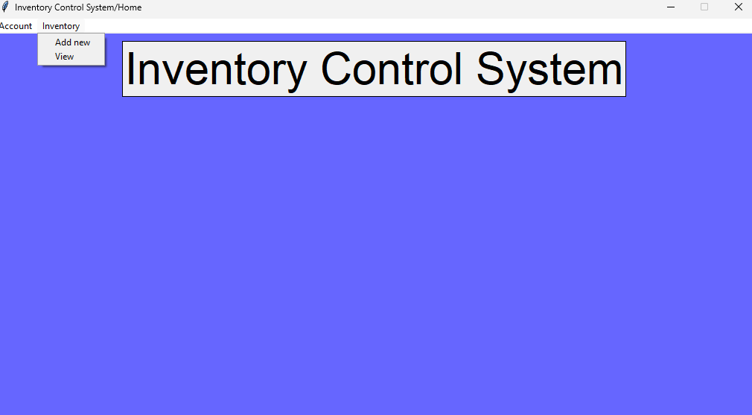
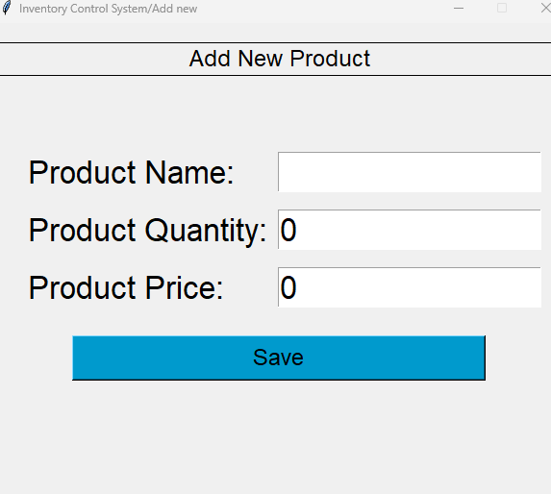
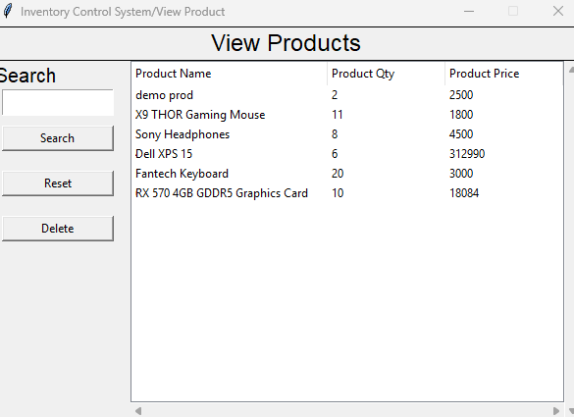
Visuals:

Slide 12
Conclusion
Content:
Summary:
A fully working inventory system with all core features
Easy-to-use interface with Tkinter and seamless interaction with SQLite dabase
A solid foundation for further improvements and additional features

